Slide 1
ODOT QUICK DESIGN CLASS – VEGETATED BIOFTILER BMPS

Slide 2
Overview
Vegetated Biofilter Design
Treatment Credit Considerations
Plan Components for Improved Construction
Performance Metrics / Maintenance

Slide 3
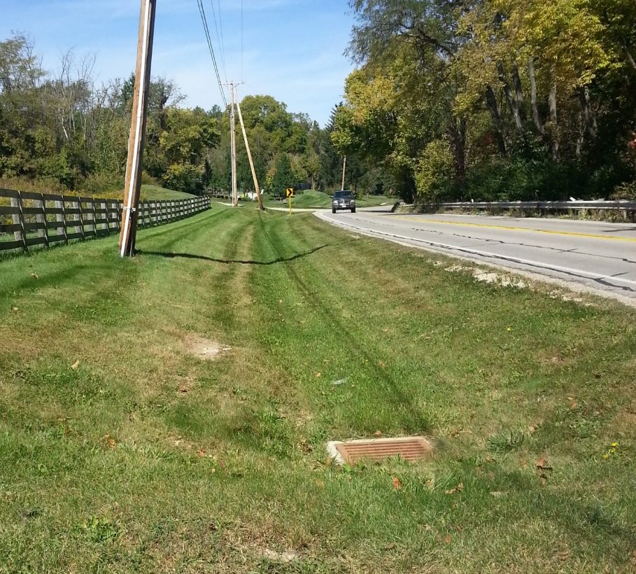
Vegetated Biofiler
L&D Vol. 2 Section 1117.2.2
Provides quality treatment only (not quantity)

Slide 4
Vegetated Biofilter
Treatment Processes

Slide 5
Design Process
Treatment Goals
Siting Analysis
Vegetated Biofilter Sizing

Slide 6
Design Process
Treatment Goals
Siting Analysis
Vegetated Biofilter Sizing

Slide 7
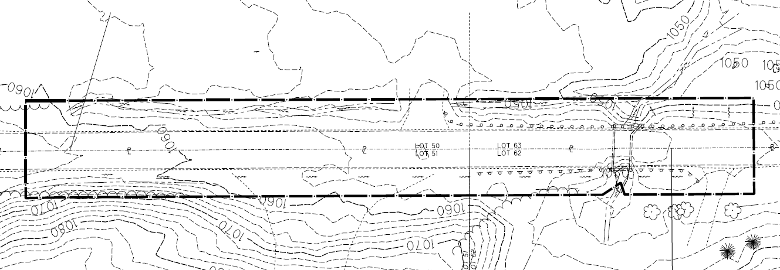
Project Example
Rural highway redevelopment
Improve shoulders
All within existing right-of-way

Slide 8
Treatment % Calculations
Redevelopment: 20%
New Construction: 100%
All area within existing R/W is considered impervious for post-construction BMP calculations.
  But not for new R/W…

Slide 9

Treatment % Calculations
Weighted treatment calculation:
  $$T\%= \frac{\left(Aix × 20\right)+(Ain × 100)}{(Aix+Ain)}$$
  T% = Treatment %
  Aix = Project EDA that is inside the existing right-of-way (acres)
  Ain = Inside new permanent right-of-way, Ain is the new impervious area minus any impervious area that is removed (acres)

Slide 10
Project Example – Treatment Goals
Project EDA = 3.0 ac
All within existing right-of-way
A_{ix} = 3.0 ac; A_{in} = 0.0 ac
T% = [(A_{ix} x 20)+(A_{in} x 100)] / (A_{ix} + A_{in})
T% = [(3.0 x 20)+(0.0 x 100)] / (3.0 + 0)
T% = 20%
20% x 3.0 ac = 0.6 ac

Slide 11
Project Example – Treatment Goals
Project EDA = 3.0 ac >= 1 ac
  Need a post-construction BMP
Treatment % = 20%
  Required to treat 0.6 ac
All in existing right-of-way
  All existing right-of-way considered impervious
  Also, there is no new permanent right-of-way
  Therefore no “new impervious area in new permanent right-of-way”
  Water quality treatment only required

Slide 12
ODOT Design Resources
ODOT Internet Site
Office of Hydraulic Engineering
Post Construction Storm Water BMP
BMP_Calcs_(Updated Jan 2017).xls
https://www.dot.state.oh.us/Divisions/Engineering/Hydraulics/Pages/PostConstructionStormWaterBMP.aspx

Slide 13
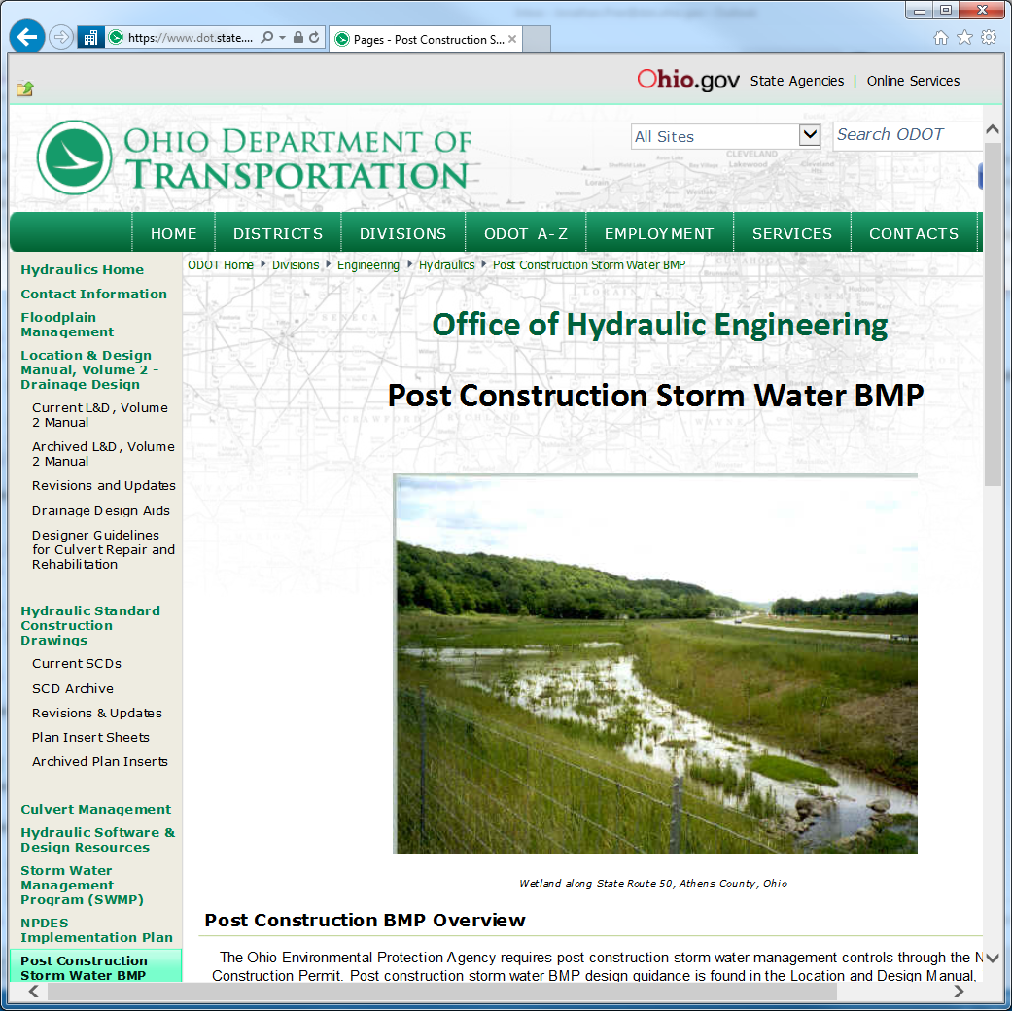

Slide 14
ODOT Design Resources
BMP_Calcs_(Updated Jan 2017).xls

Slide 15
ODOT Design Resources

Slide 16
Design Process
Treatment Goals
Siting Analysis
Vegetated Biofilter Sizing

Slide 17
Siting Analysis
Vegetated biofilters are at least 4 ft wide
Vegetated biofilters should receive unconcentrated flow along foreslope
Look for existing grass ditches to make a little wider
Use only if vegetated filter strip does not fit

Slide 18
Siting Analysis

Slide 19
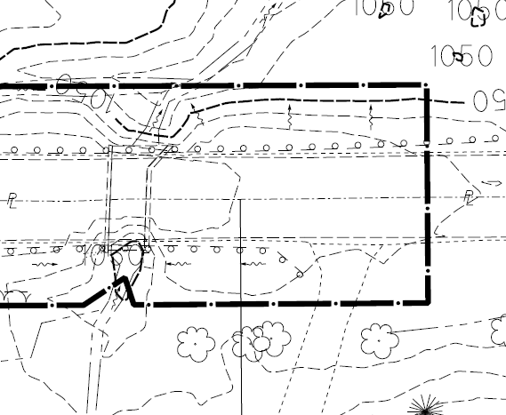
Sheet Flow
0.16 acres
sheet flow

Slide 20
Sheet Flow
L&D Vol. 2 Section 1116.1
  “For projects where the drainage sheet flows off the roadway and continues outside existing or proposed right-of-way, do not channelize flow for the sole purpose of providing a post-construction BMP. Treatment is not required for areas where sheet flow off the roadway continues to sheet flow outside ODOT right-of-way. Areas where this occurs should be documented in the post-construction BMP calculations and identified on the Project Site Plan.”

Slide 21
Treatment Goals - Updated
Treatment not required for 0.16 ac sheet flow
(Project EDA – sheet flow) * T%
(3.0 ac – 0.16ac) * 20% = 0.57 ac
WARNING! Not This Way
(3.0 ac * 20%) – 0.16 ac = 0.44 ac

Slide 22
Design Process
Treatment Goals
Siting Analysis
Vegetated Biofilter Sizing

Slide 23
Siting Analysis

Slide 24
Design Process
Treatment Goals
Siting Analysis
Vegetated Biofilter Sizing

Slide 25
Vegetated Biofilter Sizing
Size a vegetated biofilter for each ditch and pick the best one for the project.

Slide 26
Tributary Area
Notes:
Reminder: Draw drainage basin boundaries perpendicular to contours
Look for drainage divides and for ditches

Slide 27
Treatment Credit
Trib. Area = 4.0 ac
R/W Area = 1.1 ac

Slide 28
Coefficient of Runoff – WQ_{F} BMP
Right-of-Way = 1.1 ac; C = 0.9
Woods = 2.9 ac; C = 0.3
Weighted C = [(1.1*0.9)+(2.9*0.3)] / (1.1+2.9) = 0.465

Slide 29
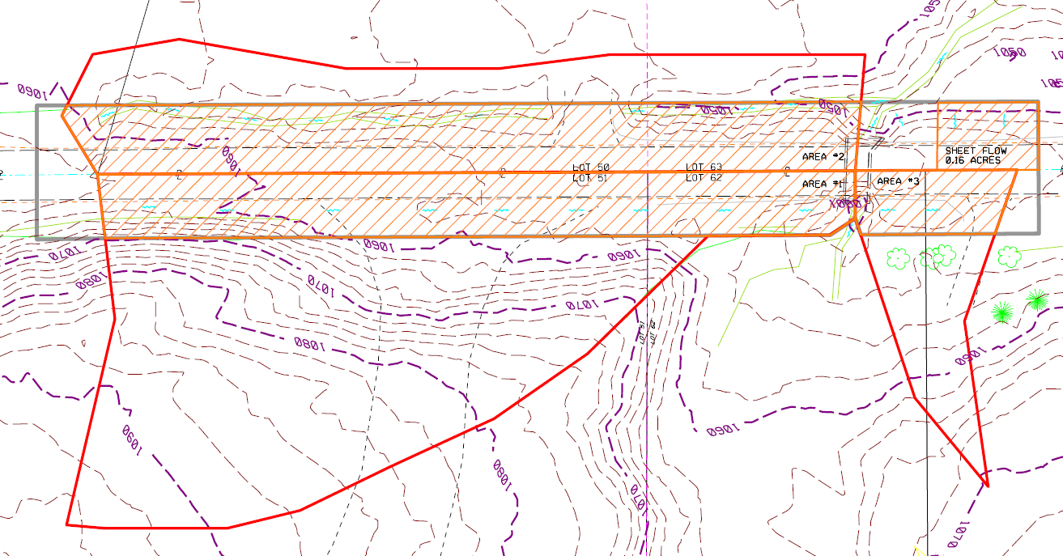
Vegetated Biofilter Sizing
2
1
3

Slide 30
Vegetated Biofilter Sizing
Area 1 (4.0 ac):
  1.1 ac within R/W; C=0.9
  2.9 ac woods; C=0.3
  (1.1ac * 0.9 + 2.9ac * 0.3) / 4.0 ac
  Weighted C = 0.465
  WQ_{F} = 0.465 * 0.65in/hr * 4.0ac = 1.209 cfs
  Treatment credit = 1.1 ac
  1.1 ac > 0.57 ac

Slide 31
ODOT Design Resources
BMP_Calcs_(Updated Jan 2017).xls

Slide 32
ODOT Design Resources

Slide 33
Vegetated Biofilter Sizing
2
1
3

Slide 34
Vegetated Biofilter Sizing
Area 2 (2.1 ac):
  1.3 ac within R/W; C=0.9
  0.8 ac woods; C=0.3
  (1.3ac * 0.9 + 0.8ac * 0.3) / 2.1 ac
  Weighted C = 0.67
  WQ_{F} = 0.67 * 0.65in/hr * 2.1ac = 0.915 cfs
  Treatment credit = 1.3 ac
  1.3 ac > 0.57 ac

Slide 35
Vegetated Biofilter Sizing
2
1
3

Slide 36
Vegetated Biofilter Sizing
Area 3 (0.6 ac):
  0.2 ac within R/W
  Since 0.2 ac < 0.57 ac treatment requirement, don’t go any further

Slide 37
Vegetated Biofilter Sizing
Determine vegetated biofilter bottom width for Area 1 and Area 2: Manning’s Equation:
(0.15 for Vegetated Biofilter)

Slide 38
Vegetated Biofilter Sizing
Q = WQ_{F} calculated using Rational Method
n = 0.15 (for flow within height of grass)
Depth <= 4 inches
Velocity <= 1 fps
Project Specific
Specified in L&D

Slide 39
Vegetated Biofilter Sizing
Use a program or spreadsheet, given:
  Q
  n
  Channel geometry
  Longitudinal slope
Calculate
  Normal depth
  Average velocity

Slide 40
Vegetated Biofilter Sizing
1

Slide 41
Vegetated Biofilter Sizing – Area 1
Longitudinal slope = 0.01 ft/ft
Assume fore slope = 2:1
Assume back slope = 2:1
Manning’s n = 0.15
Q = 1.209 cfs
Use trial and error until you find a bottom width that gives a velocity <= 1 fps and a depth <= 4 in

Slide 42
Vegetated Biofilter Sizing – Area 1
See FHWA Hydraulic Toolbox 4.20
See ODOT Excel spreadsheet

Slide 43
ODOT Design Resources
BMP_Calcs_(Updated Jan 2019).xls

Slide 44
ODOT Design Resources

Slide 45
ODOT Design Resources

Slide 46
Vegetated Biofilter Sizing
Area | Q | s | FS | BS | n | B | Vel. | Depth
 | cfs | ft/ft | H:V | H:V |  | ft | fps | in
1 | 1.209 | 0.01 | 2:1 | 2:1 | 0.15 | 8 | 0.44 | 3.83
2 | 0.915 | 0.01 | 2:1 | 2:1 | 0.15 | 6 | 0.43 | 3.84

Slide 47
Vegetated Biofilter Sizing
2
6 FT
1
8 FT
3

Slide 48
Vegetated Biofilter Sizing
Area 2 treatment credit = 1.3 ac
Only need 0.57 ac
Sub-delineate to reduce BMP size
2
6 FT

Slide 49
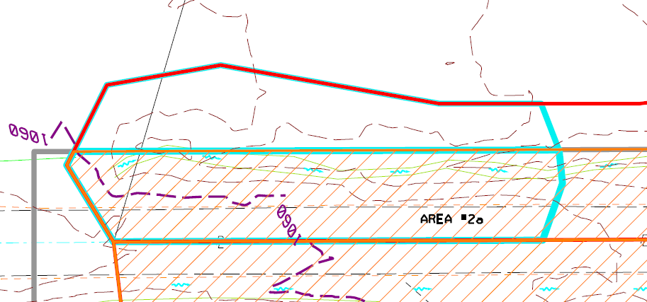
Vegetated Biofilter Sizing – Area 2

Slide 50
Vegetated Biofilter Sizing – Area 2
New area = 0.97 ac
  0.57 ac within R/W; C=0.9
  0.40 ac woods; C=0.3
  (0.57 ac * 0.9 + 0.40 ac * 0.3) / 0.97 ac
  Weighted C = 0.653
  WQ_{F} = 0.653 * 0.65in/hr * 0.97ac = 0.412 cfs
  Treatment credit = 0.57 ac
  0.57 ac = 0.57 ac

Slide 51
Vegetated Biofilter Sizing
Area | Q | s | FS | BS | n | B | Vel. | Depth
 | cfs | ft/ft | H:V | H:V |  | ft | fps | in
1 | 1.209 | 0.01 | 2:1 | 2:1 | 0.15 | 8 | 0.44 | 3.83
2 | 0.915 | 0.01 | 2:1 | 2:1 | 0.15 | 6 | 0.43 | 3.84
2a | 0.412 | 0.01 | 2:1 | 2:1 | 0.15 | 3 | 0.39 | 3.54
2a | 0.412 | 0.01 | 2:1 | 2:1 | 0.15 | 4 | 0.36 | 3.02

Slide 52
Vegetated Biofilter Sizing – Area 2

Slide 53
Overview
Vegetated Biofilter Design
Treatment Credit Considerations
Plan Components for Improved Construction
Performance Metrics / Maintenance

Slide 54
Vegetated Biofilter Treatment Credit
ODOT L&D Vol 2, Section 1117.2.2
Treatment Credit for Vegetated Biofilter is given to:
Areas within the project limits that sheet flow off of the roadway into a grassed shoulder, grassed foreslope, and then into a grassed trapezoidal ditch sized as described above. (Tributary areas to a Vegetated Biofilter that do not meet this criteria, i.e. drainage from concentrated flow or outside project limits, must be included in the determination of the EBW, but do not receive treatment credit.)
The area of the defined Vegetated Biofilter (the shoulder, foreslope, ditch bottom, and backslope) within the permanent right-of-way.

Slide 55
Vegetated Biofilter Credit Example
Drainage Area

Slide 56
Vegetated Biofilter Credit Example
Drainage Area
Treatment Credit
Enhanced Bankfull Width

Slide 57
Vegetated Biofilter Credit Example
Drainage Area #2
Drainage Area #1

Slide 58
Vegetated Biofilter Credit Example
Drainage Area #2
Drainage Area #1
Treatment Credit
Treatment Credit
Enhanced Bankfull Width

Slide 59
Vegetated Biofilter Credit Example
Drainage Area #2
Drainage Area #1
No Treatment Credit
Treatment Credit
Enhanced Bankfull Width
(Width Still Sized for Both Drainage Areas)

Slide 60
Vegetated Biofilter Credit Example
Offsite Drainage Area #3
Drainage Area #2
Drainage Area #1

Slide 61
Vegetated Biofilter Credit Example
Offsite Drainage Area #3
(No Treatment Credit)
Drainage Area #2
Drainage Area #1
No Treatment Credit
Treatment Credit
Enhanced Bankfull Width
(Width Sized for All Drainage Areas)

Slide 62
Overview
Vegetated Biofilter Design
Treatment Credit Considerations
Plan Components for Improved Construction
Performance Metrics / Maintenance

Slide 63
Vegetated Biofilter Plan Components
Add 4” of Item 659 topsoil to the vegetated portion of the shoulder and foreslope
Add Item 670, Ditch Erosion Protection
Show vegetated biofilters on Project Site Plan
Call out vegetated biofilters on plan / profile sheets
Call out vegetated biofilters on cross sections

Slide 64
Overview
Vegetated Biofilter Design
Treatment Credit Considerations
Plan Components for Improved Construction
Performance Metrics / Maintenance

Slide 65
Performance Metrics
80% Grass Coverage on Foreslope, Bottom, and Backslope
No Ruts, Rills, Gullies, or Concentrated Flow
Flat Ditch Bottom
Remove Accumulated Trash and Sediment

Slide 66
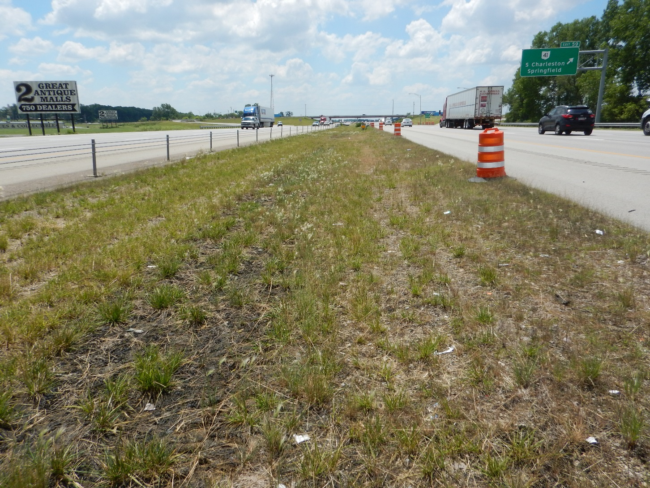
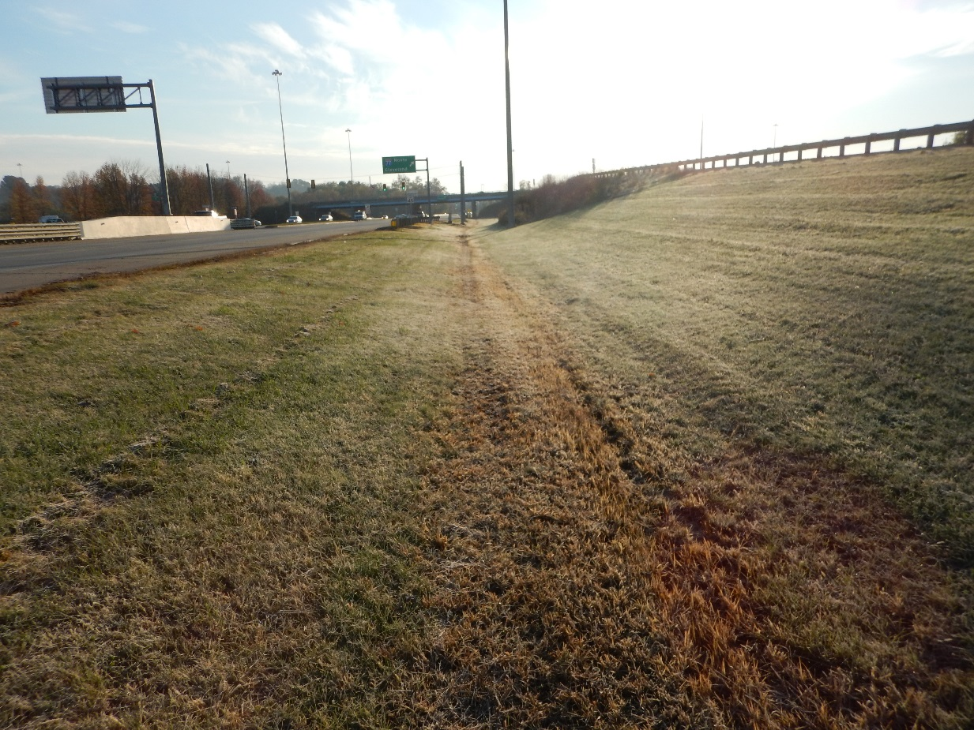
Initial Grass Establishment
80% Grass Coverage

Slide 67
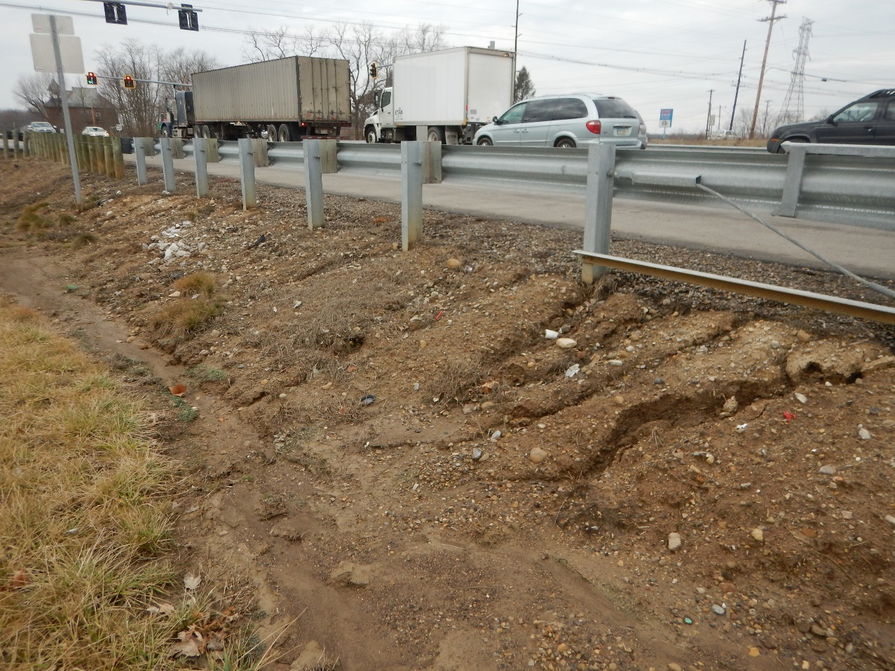
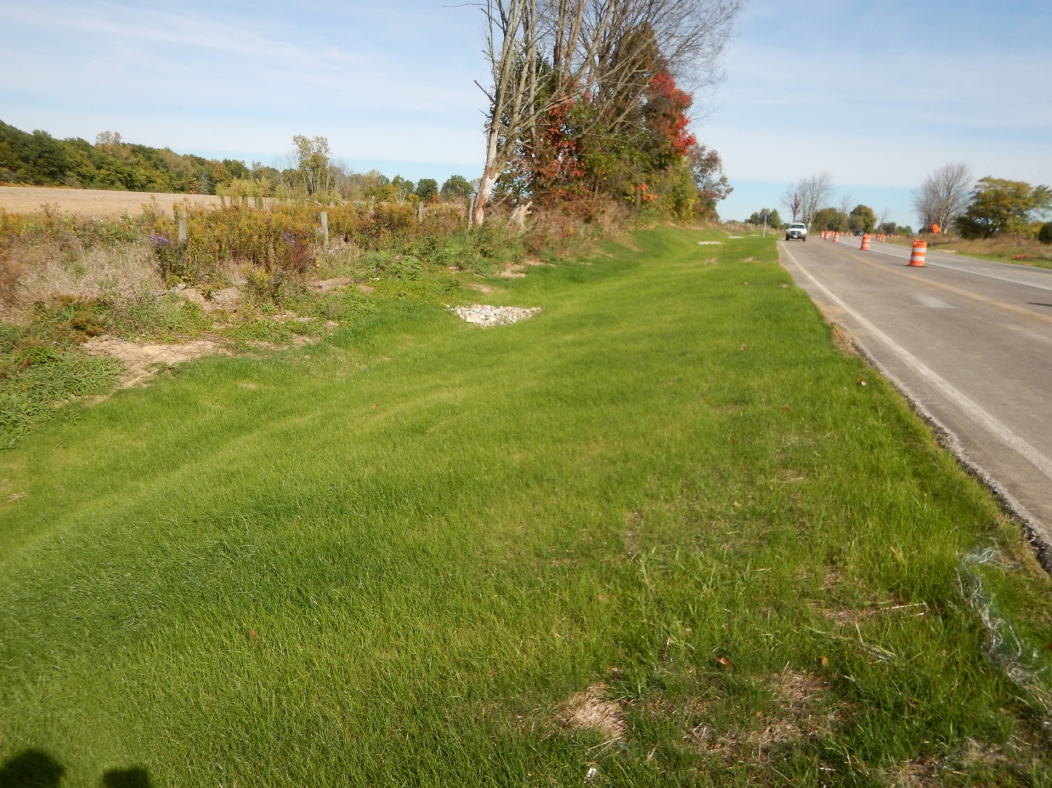
Initial Grass Establishment
Rills & 80% Grass Coverage

Slide 68
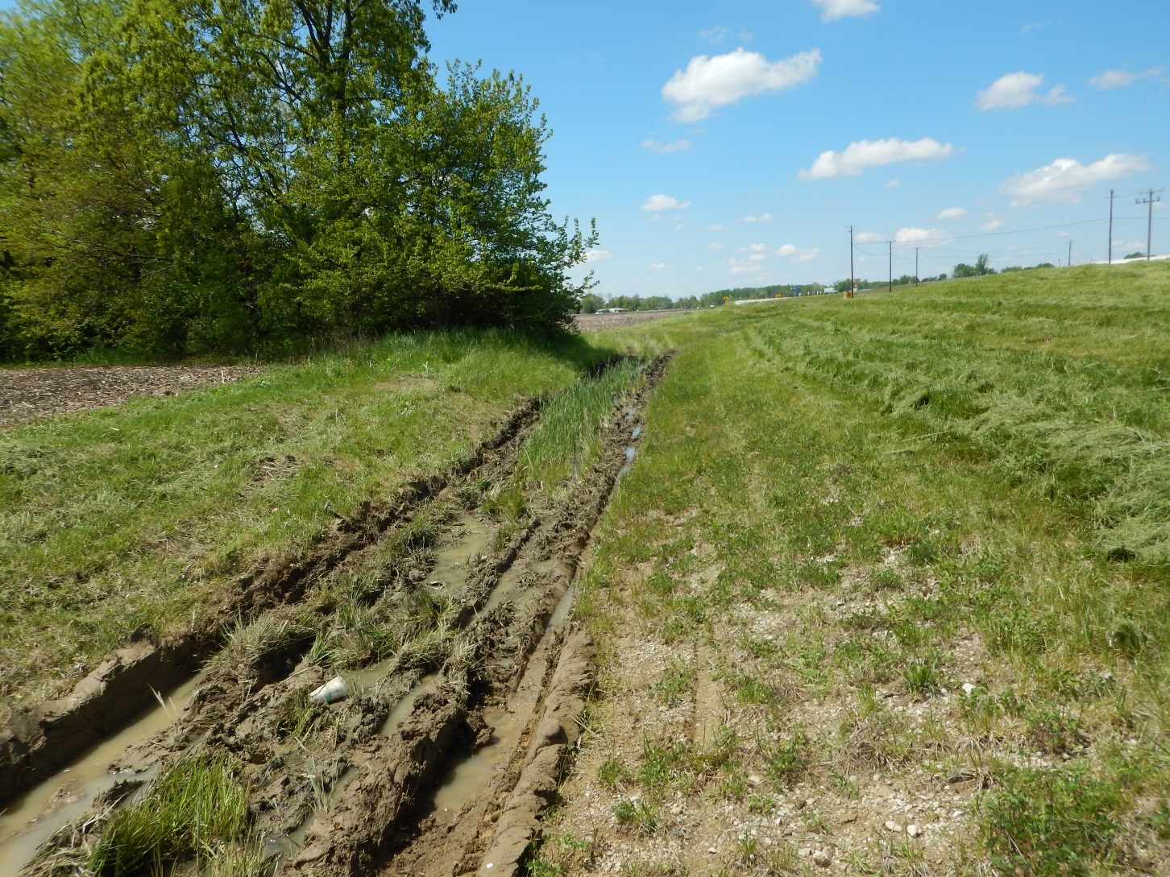
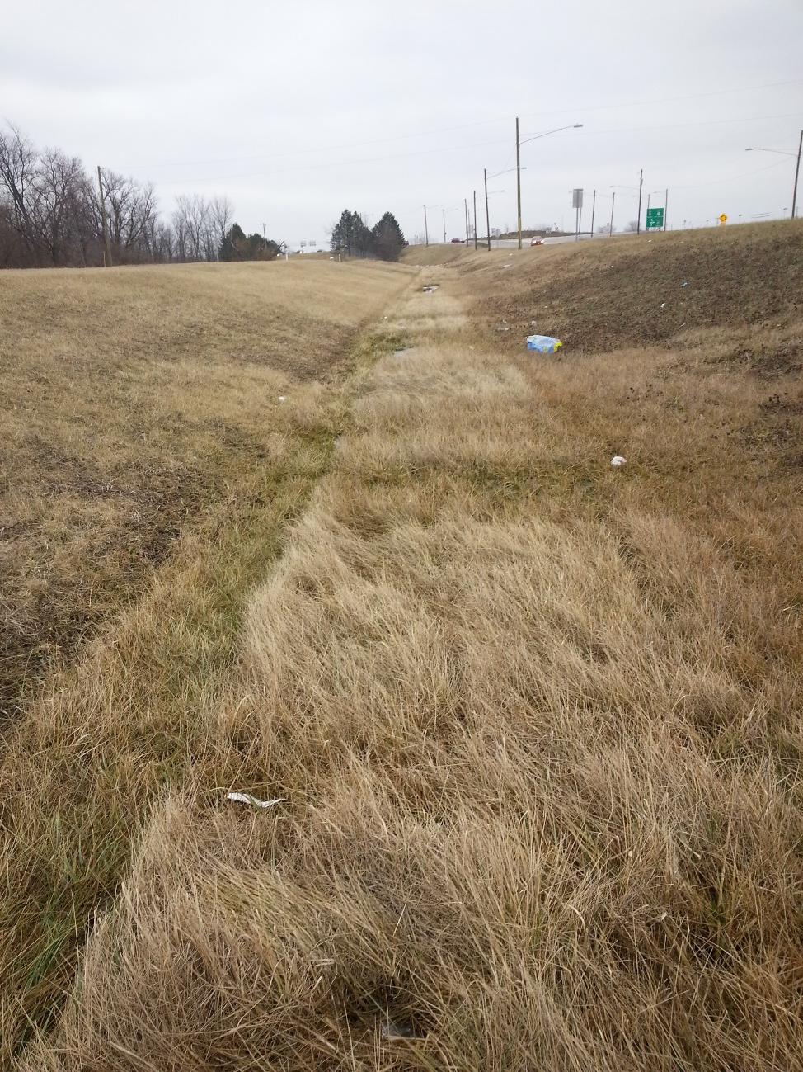
Don’t Mow When Wet
Ruts & 80% Grass

Slide 69
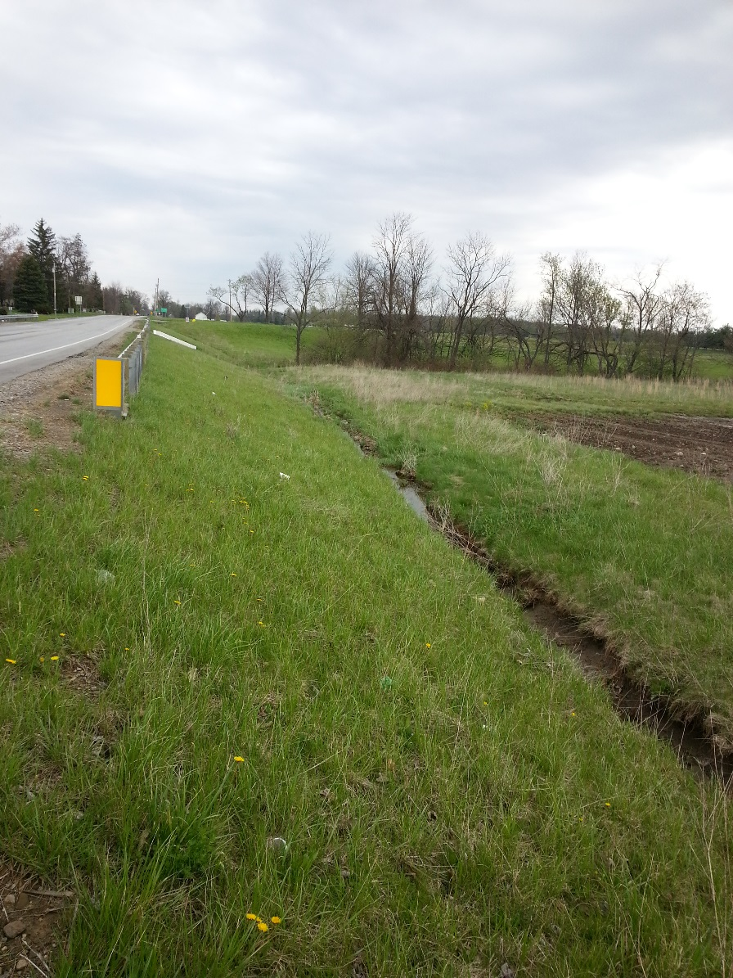
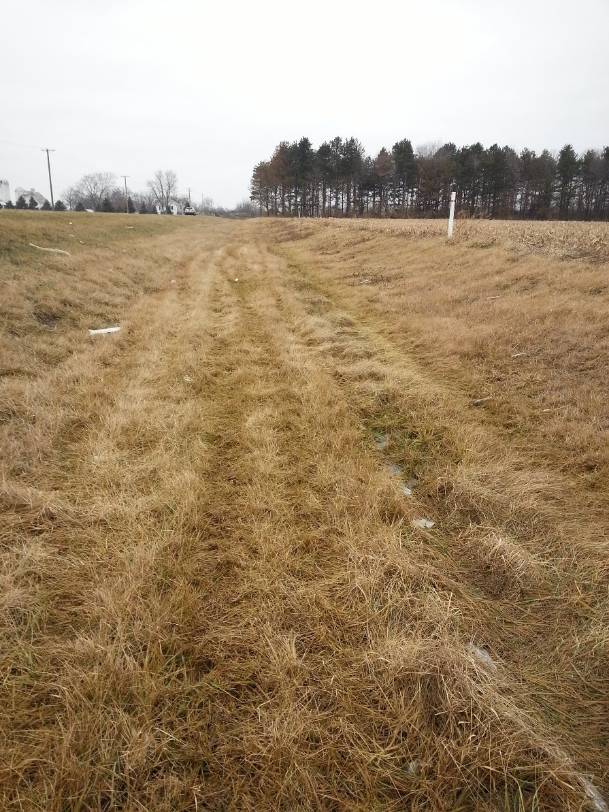
Erosion Protection and Catch Downcutting Early
Gullies / Concentrated Flow

Slide 70
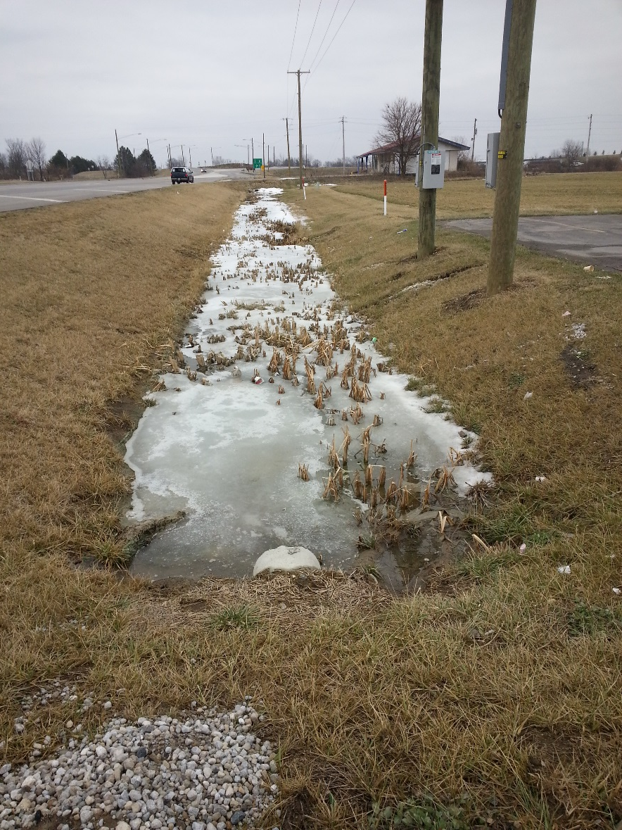
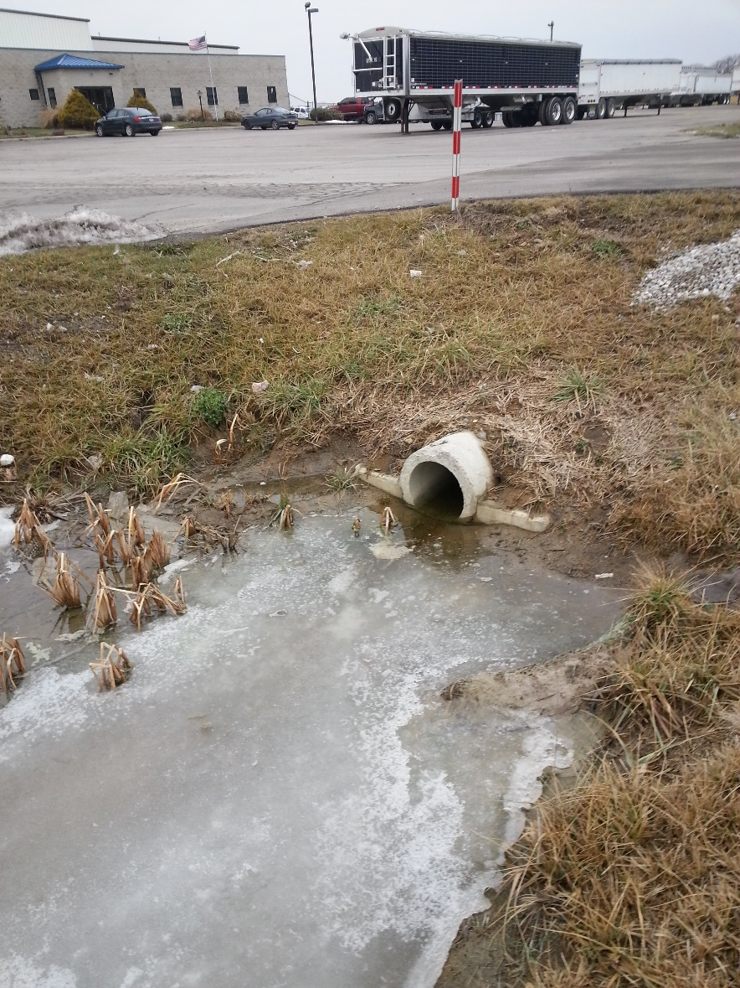
Maintain Positive Drainage
Don’t Design too Flat; Clear Downstream

Slide 71
Maintenance
Keep Grass Alive
Mow at least Twice a Year
Don’t Mow when Wet
Catch Downcutting Early
After Sediment does Accumulate, must Regrade and Re-establish Grass
  Grading Different than Normal Ditching to Get Flat Bottom

Slide 72
Questions ?
Jon Prier, P.E.
jonathan.prier@dot.ohio.gov
614-644-1876

